Slide 1
Visual Presentation #2
By: Edward Arroyo, Jahbari Dessout, William Ferris, and Eliexer Gomez

Slide 2

Gen Fitness
The business we are consulting for is the nonprofit organization Gen Fitness.

Slide 3


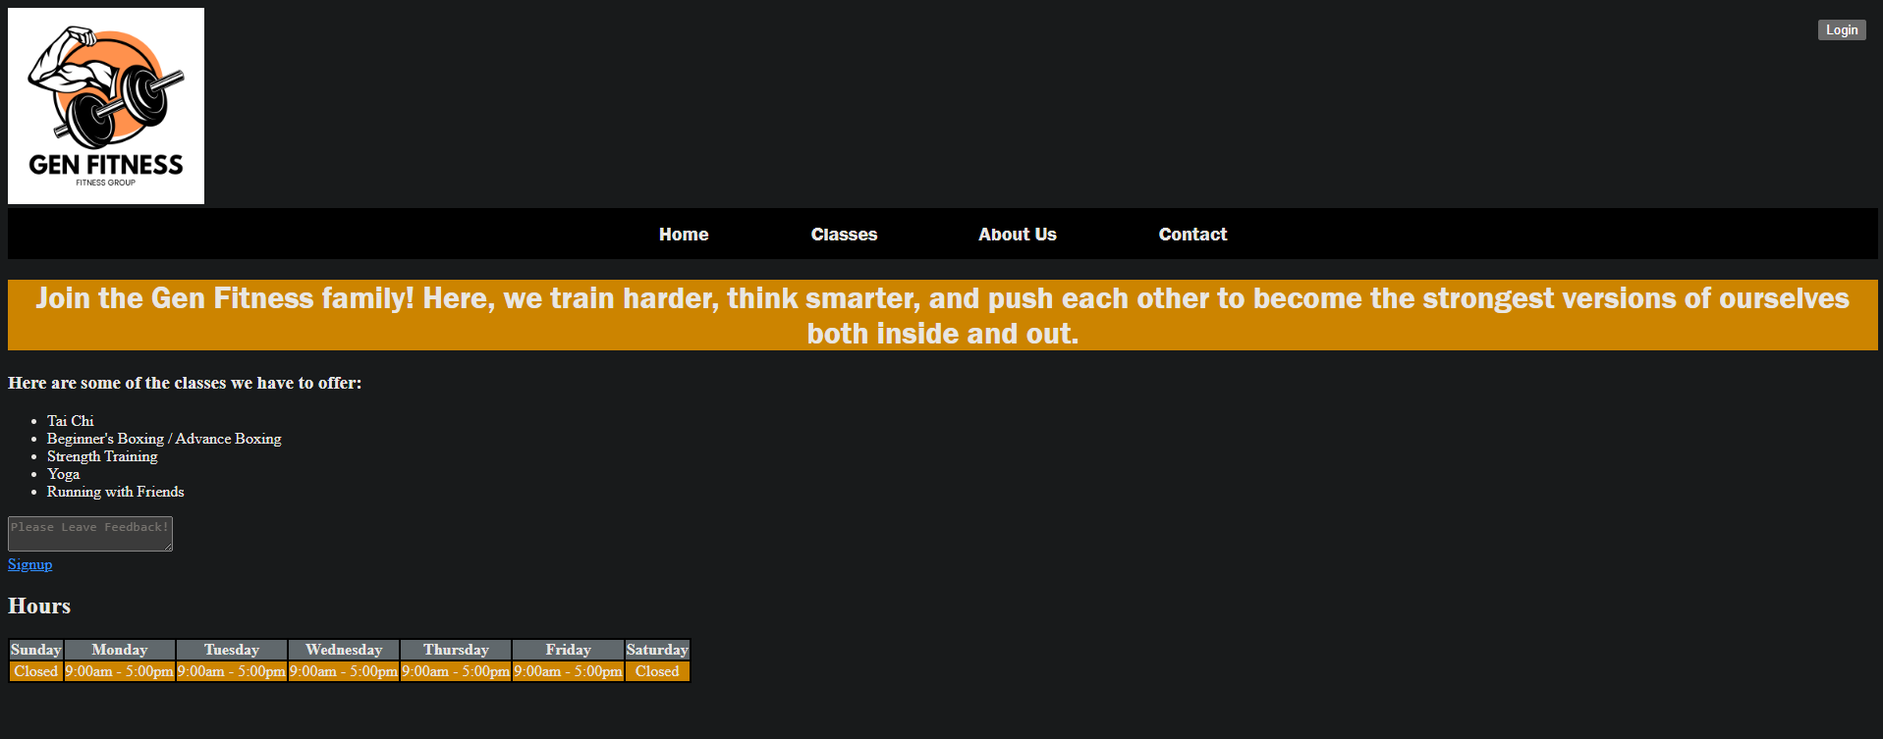



Home Page

Slide 4
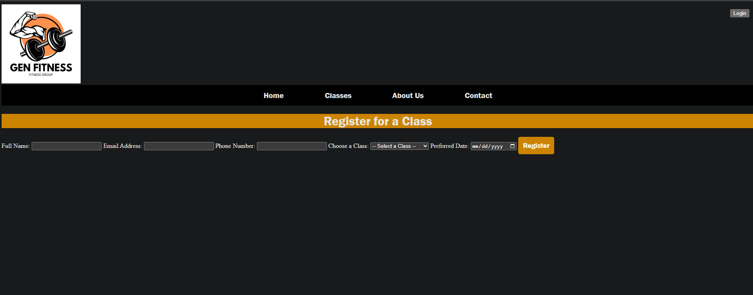
Sign Up Page

Slide 5


Slide 6
Roles
Website design and implementation - Jahbari Dessout
Backend and scripting - William Ferris
Project documentation - Edward Arroyo Diaz & Eliexer Gomez
Github repository management - Jahbari Dessout

